Slide 1

Regenesys School of Technology
Bachelor of Science in Computer Science
Ms. Preeti Mishra | preeti.m@regenesys.net
DATE: 8 June 2024

Slide 2

Preeti Mishra
With 16 years of expertise spanning Software Testing & Development, Product Management, Training & Facilitation, and Academia
Qualifications-
M.E.(Specialization- Software Engineering)
B.E.(Computer Engineering)
Well versed in programming languages - C, C++, Python, Java, R. Concepts- Data Structures, Software Engineering, Systems Programming, Compiler Design, Object-oriented analysis and design. Tools – Excel, PowerBI.
Provided Expert Guidance on Projects
Bagged a few Research Publications and one Patent
Certifications from NPTEL, EdX, Coursera in Technology, Management & Teaching Learning Fields.
2

Slide 3
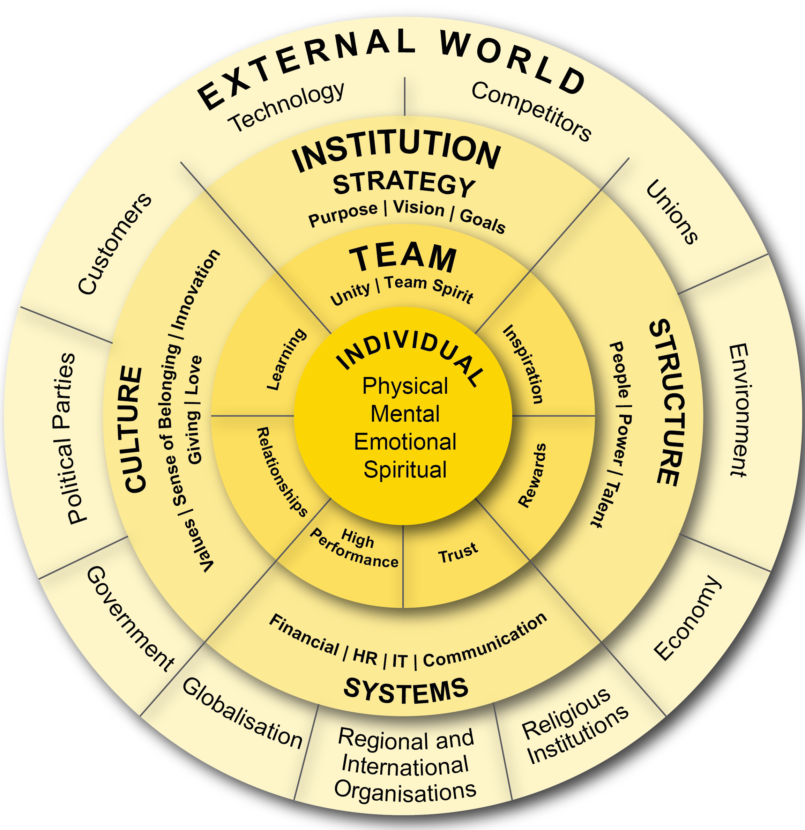
Regenesys’ Integrated Leadership and Management
Model
Holistic focus on the individual (SQ, EQ, IQ, and PQ)
Interrelationships are dynamic between individual, team, institution and the external environment (systemic)
Strategy affects individual, team, organisational, and environmental performance
Delivery requires alignment of of strategy, structure, systems and culture

Slide 4
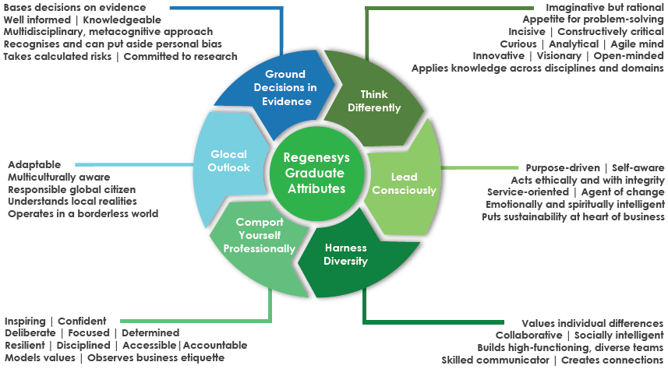
Regenesys’ Graduate Attributes

Slide 5

Ground Rules
Be open-minded: Embrace new perspectives and ideas.
Use "I think," "I feel," etc.: Your voice matters in this learning journey.
Listen carefully: Respectfully engage with others' contributions.
One conversation at a time: Ensure everyone has a chance to speak.
Respect others' opinions: Value diverse viewpoints.
Give constructive feedback: Offer helpful insights to support growth.
Build on ideas: Collaborate and enhance each other's thoughts.
Powered by DALL·E 3
5

Slide 6

Learning Outcomes
On completing this course, students should be able to:
Identify the problem statement
Label variables using appropriate variable naming rules.
Select appropriate operators required for the computation.
List intermediate and final output using print statement.
Describe and apply the core principles and concepts of procedural programming.
Define and initialise variables with appropriate value.
Identify and implement control structures like if-else, if-elif-else, nested if else, while loop and for loop.
Define and implement customised Python function with components like function header, docstring, parameter, function body, return statement, function call, local variable.
Develop programs incrementally, breaking down complex tasks into manageable parts.
Examine outcome of the program with simple tests, automated tests depending upon the scenario.
Describe the concept of modular software design.
State the advantages of modular software design.
Apply modular software design technique to decompose programs into modular components.
Implement the Python program to store input and output data using built-in collections like list, tuple, dictionary, string.
Implement the Python program using Pandas package to read and write data into simple text files, such as CSV and JSON files.
Powered by DALL·E 3
6

Slide 7
Learning Outcomes
Understand the pseudocode description of algorithm. ​
Implement the code for pseudocode algorithm to enhance logical thinking and problem-solving abilities.​
Describe and implement data storage and data handling in stacks data structure using Python.​
Describe and implement data storage and data handling in queues data structure using Python.​
Describe and implement date, time related library code.​
Describe and implement social media related library code.​
Identify steps involved in installation of software development environment. ​
Examine components of software development environment. ​
Use software development environment to coding and debugging and project management.​
Use print statement for code debugging.​
Use software development environment specific debugger options like breakpoints, step through code, inspect variables.​
Organise and document program code according to software engineering principles, making it readable and maintainable.​
Explain the design and implementation of their own code and comprehend and interpret documentation for supplied example code.​
Design custom data structures tailored to specific requirements for storing and managing the states of a process.​
Design Python functions to represent complex states of a process.​
Design Python class to encapsulating relevant information and process.​ ​
Powered by DALL·E 3
7

Slide 8

Quick Recap of Last Session
Procedural Programming Continued..
Functions in Python
Call and Return from a function
Scope of Variable
Key points 2.5
Default Parameter
Powered by DALL·E 3
8

Slide 9

Outline
Modular Programming
Object Oriented Programming
Testing
Documentation Tools
Practice tasks
Key points 2.6
Powered by DALL·E 3
9

Slide 10
Next up..
2.6 Modular Programming and Object-Oriented Paradigm
10

Slide 11
Next up..
Modular Software Design
11

Slide 12
Modular Software Design
Modular software design is a software engineering concept that involves breaking down
a complex software system into smaller, self-contained modules or components
Each module is responsible for a specific piece of functionality and can be developed, tested, and maintained independently.
These modules interact with each other through well-defined interfaces, allowing the construction of a larger software system from smaller, reusable building blocks.
Principles of Modular Software Design
Decomposition
Abstraction
Encapsulation
Reusability
Modularity

Slide 13
Decomposition
Breaking down a complex problem or system into smaller, manageable parts or modules.
Each module should have a clear and well-defined purpose.

Slide 14
Abstraction
Hiding the internal details of a module and providing a simplified and consistent interface to interact with it.
Users of the module do not need to know how it works internally.

Slide 15
Encapsulation
Keeping the internal data and implementation details of a module hidden from the outside world.
This helps prevent unintended interference and ensures data integrity.

Slide 16
Reusability
Designing modules that are reusable in multiple parts of a software system or even in different projects.
Reusable modules reduce development time and the chances of errors.

Slide 17
Modularity
Creating modules that are independent and loosely coupled.
This allows for easy replacement, modification, and maintenance of individual modules
without affecting the entire system.

Slide 18
Advantages of Modular Software Design
Advantages of Modular Design
Simplicity
Reusability
Ease of Maintenance
Parallel Development
Scalability
Testing
Collaboration
Code Maintenance
Code Quality
Notes:
Simplicity: Breaking a complex problem into smaller modules makes the overall system easier to understand, develop, and maintain. Each module focuses on a specific aspect of the problem, reducing complexity.
Reusability: A modular design promotes the creation of reusable components. Once a module is developed and tested, it can be used in multiple parts of the software system or in other projects, saving development time and effort.
Ease of Maintenance: When a bug is discovered or a new feature needs to be added, developers can focus on individual modules without disrupting the entire system. This makes debugging and maintenance more efficient.
Parallel Development: Multiple developers or teams can work on different modules simultaneously. As long as the interfaces are well defined, their work can be seamlessly integrated into the overall system.
Scalability: New functionality can be added by creating new modules or extending existing ones rather than rewriting the entire system. This makes it easier to adapt the software to changing requirements.
Testing: Modules can be tested independently, allowing for thorough unit testing before integration. This approach improves the reliability and stability of the software.
Collaboration: A modular design encourages collaboration among team members. Each team member can be responsible for a specific module, leading to a more efficient development process.
Code Maintenance: When a module needs to be updated or replaced, it can be performed without affecting the rest of the system. This extends the lifespan of software applications.
Code Quality: A modular design enforces clean interfaces and separates concerns, leading to better code organisation and improved code quality.

Slide 19
Advantages of Modular Programming over Procedural Programming
Improved code organisation and readability.
Enhanced code reusability and maintainability.
Reduced complexity through encapsulation and abstraction.
Better data integrity and reduced risk of bugs due to the global state.
Easier collaboration among developers, as they can work on separate modules.
Scalability and adaptability to changing requirements.

Slide 20
Next up..
Object Oriented Paradigm
20

Slide 21
Object-Oriented Paradigm
The object-oriented paradigm is a programming approach that focuses on modelling software using objects.
Objects represent real-world entities and encapsulate data (attributes) and behavior related to those entities.
Class and object
A class is a blueprint or template for creating objects. It defines the structure and behavior that objects of that class will have.
An object is an instance of a class. It is a concrete instantiation of the class blueprint, with its own set of attributes and data.

Slide 22
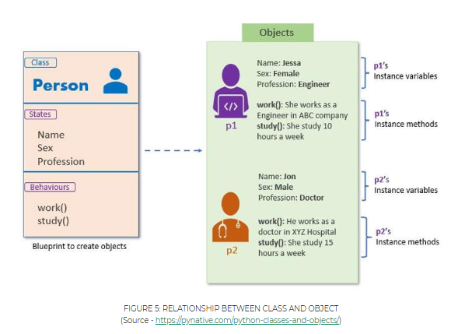
Object-Oriented Paradigm

Slide 23
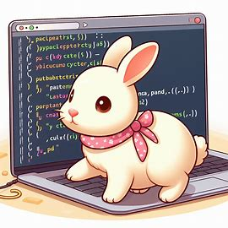
Next up..
Code walkthrough
Powered by DALL·E 3
23

Slide 24
Constructor
A constructor is a special method for initialising the attributes of an object when it is created.
In Python, the constructor method is named __init__.
It's automatically called when you create an object from the class.

Slide 25
Self Keyword
In Python, self is a conventionally used name for the first parameter of instance methods in a class.
It refers to the instance of the class itself, allowing you to access and modify
the object's attributes and call its methods within the class.

Slide 26
Principles of OOP
Data Security
Encapsulation
Code Reusability
Inheritance
Hides Complexity
Abstraction
Code flexibility
Polymorphism

Slide 27
Encapsulation
Encapsulation is a fundamental OOP concept that involves bundling data (attributes or properties) and the methods (functions) that operate on that data into a single unit called an object.
It promotes data integrity and the principle of "hiding the internal details."
Key points about encapsulation-
Attributes are typically marked as private (often indicated by a prefix such as _) to restrict direct access.
Access to the attributes is provided through methods (getters and setters) to control how the data are accessed and modified.

Slide 28
Inheritance
Inheritance is a mechanism that allows a new class (a subclass or derived class) to inherit properties and behaviours (attributes and methods) from an existing class (a superclass or base class).
It promotes code reuse and establishes an "is-a" relationship between classes.
Key points about inheritance:
A subclass inherits attributes and methods from its superclass, but it can also have additional attributes and methods or override inherited attributes and methods.
Inheritance allows one to create a hierarchy of classes with shared characteristics.

Slide 29
Polymorphism
A polymorphism is the ability of different objects to respond to the same method name in a way that is appropriate for their individual types.
Polymorphism promotes flexibility and extensibility in code.
Key points about polymorphism:
Polymorphism is achieved through method overriding (a subclass providing its own implementation of a method inherited from a superclass).
It allows you to write generic code that can work with objects of various subclasses without knowing their specific types.

Slide 30
Abstraction
Abstraction is the process of simplifying complex reality by modelling classes based on the essential properties and behaviours of an object.
Abstraction allows you to focus on the essential features of an object while ignoring irrelevant details.
It is a way to manage complexity by creating abstract representations.
Key points about abstraction:
Abstraction involves defining classes that hide the implementation details and provide a clear and simplified interface for users.
Users of a class interact with its abstracted interface without needing to understand the underlying implementation.

Slide 31
Next up..
Code walkthrough
Powered by DALL·E 3
31

Slide 32
Next up..
Software Testing
32

Slide 33
Software Testing
Software testing is the process of evaluating a software application or system
to identify and rectify defects, errors, or issues.
Testing ensures that the software functions as intended, meets specified requirements,
and delivers a high level of quality to end-users.
Types of Testing
Manual Testing
Automated Testing

Slide 34
Software Testing
Visual Inspection
Testers go through the program or app, checking all the buttons, screens, and features to see if they look right and work as expected.
Functional Testing
Testers click around, enter data, and use the program to see if it behaves as it's supposed to
Safety Testing
Testers check if the program is safe from bad people trying to break into it
Performance Testing
Testers check if the program can handle lots of users
Regression Testing
very time the program gets updated, testers make sure the new changes didn't "break" anything that used to work

Slide 35
Manual Testing
Manual testing involves human testers executing test cases and interacting with the software to verify its correctness
Manual testing is effective for exploratory testing, usability testing, and test scenarios that are challenging to automate.

Slide 36
Manual Testing
Example of Manual Testing in Python
Suppose we have a simple Python function that calculates the sum of two numbers:
def add_numbers(a, b):
return a + b
For manual testing, a tester might write test cases and execute them manually:
# Manual Test Case 1
result = add_numbers(2, 3)
print("Test Case 1: Result =", result) # Expected output: 5
# Manual Test Case 2
result = add_numbers(-1, 7)
print("Test Case 2: Result =", result) # Expected output: 6
# Manual Test Case 3
result = add_numbers(0, 0)
print("Test Case 3: Result =", result) # Expected output: 0
In manual testing, testers observe the results, compare them to expected outcomes, and report any discrepancies.

Slide 37
Automated Testing
Automated testing involves using testing frameworks and scripts to automate the execution of test cases
Automated testing is efficient for regression testing, load testing, and repetitive test scenarios.

Slide 38
Automated Testing
In this automated testing example, we define test cases as methods within a test class.
The unittest framework provides assertion methods such as assertEqual to verify the results automatically.
The unittest.main() call runs the tests.

Slide 39
Automated Testing
import unittest
def add_numbers(a, b):
return a + b
class TestAddNumbers (unittest. TestCase):
def test_positive_numbers(self):
result = add_numbers(2, 3)
self.assertEqual(result, 5)
def test_negative_numbers(self):
result = add_numbers(-1, 7)
self.assertEqual(result, 6)
def test_zero_numbers(self):
result = add_numbers(0, 0)
self.assertEqual(result, 0)
if __name__ == "__main__":
unittest.main()

Slide 40
Next up..
Organisation and Documentation
40

Slide 41
Documentation Tools
Several tools and practices are available to help organise and document program code.
These tools can assist in improving code readability, maintainability, and collaboration among developers.
Commonly used tools and practices:
Pylint
GitHub
SPHINX

Slide 42
Next up..
Pylint
42

Slide 43
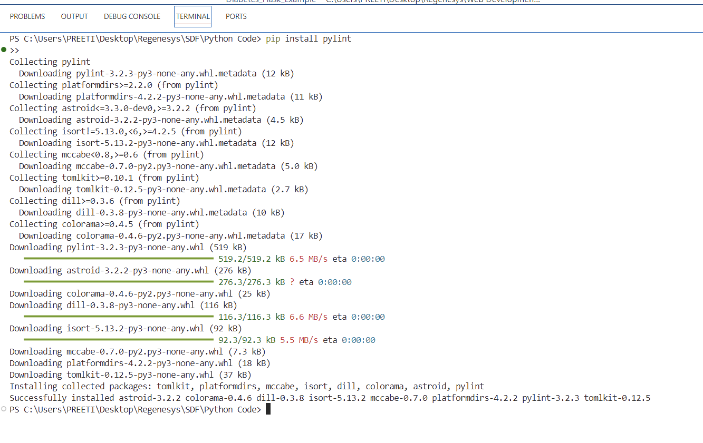
Pylint
Pylint is a powerful tool for analyzing Python code and ensuring adherence to coding standards
Installation:
Run this command on terminal
pip install pylint
Pylint is a popular static code analysis tool for Python. It checks Python code against a set of coding standards and detects potential errors, code smells, and style violations.
Key Features
Code Quality Analysis: Pylint assesses the quality of Python code by identifying issues such as undefined variables, unused imports, and code complexity.
Code Style Enforcement: This enforces coding style conventions and adherence to Python Enhancement Proposals (PEP 8) for consistent and readable code.
Extensibility: Pylint can be extended with custom rules and plugins to meet specific project requirements.
Integration: This approach can be integrated into various development environments and continuous integration (CI) pipelines.

Slide 44
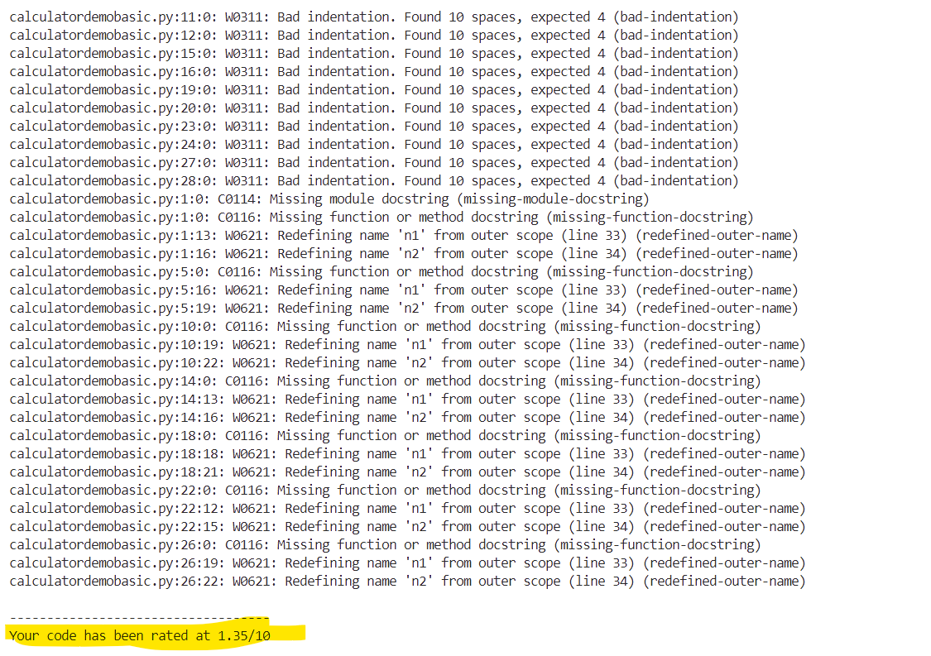
Pylint
Pylint is typically run from the command line.
You can analyze individual files, multiple files, or entire directories.
To analyze a single file:
pylint filename.py

Slide 45
Next up..
GitHub
45

Slide 46
Using GitHub
GitHub is a powerful platform for collaborative development and version control.
Create a GitHub Account
Install Git on Your Computer
Create a Git Repository:On GitHub, click the “+” symbol in the top right corner and choose “New repository.”Give your repository a name and click “Create repository.”
Add and Commit Files:Add files to your repository,Commit your changes to create snapshots of your work.
Create a Branch:Branches allow you to work on isolated features or experiments.
Create a Pull Request:When you’re ready to merge your changes back into the main branch, create a pull request.
Merge Your Pull Request:After reviewing and approving the changes, merge the pull request, Your changes are now part of the main branch.

Slide 47
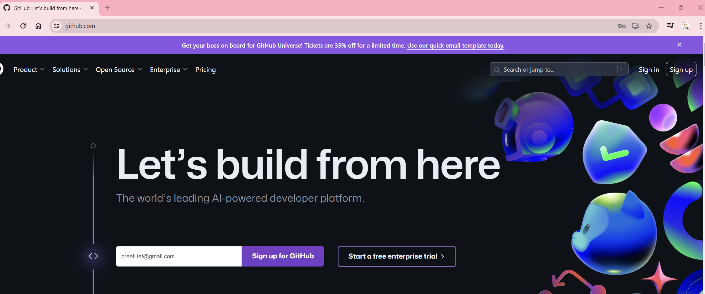
Using GitHub

Slide 48
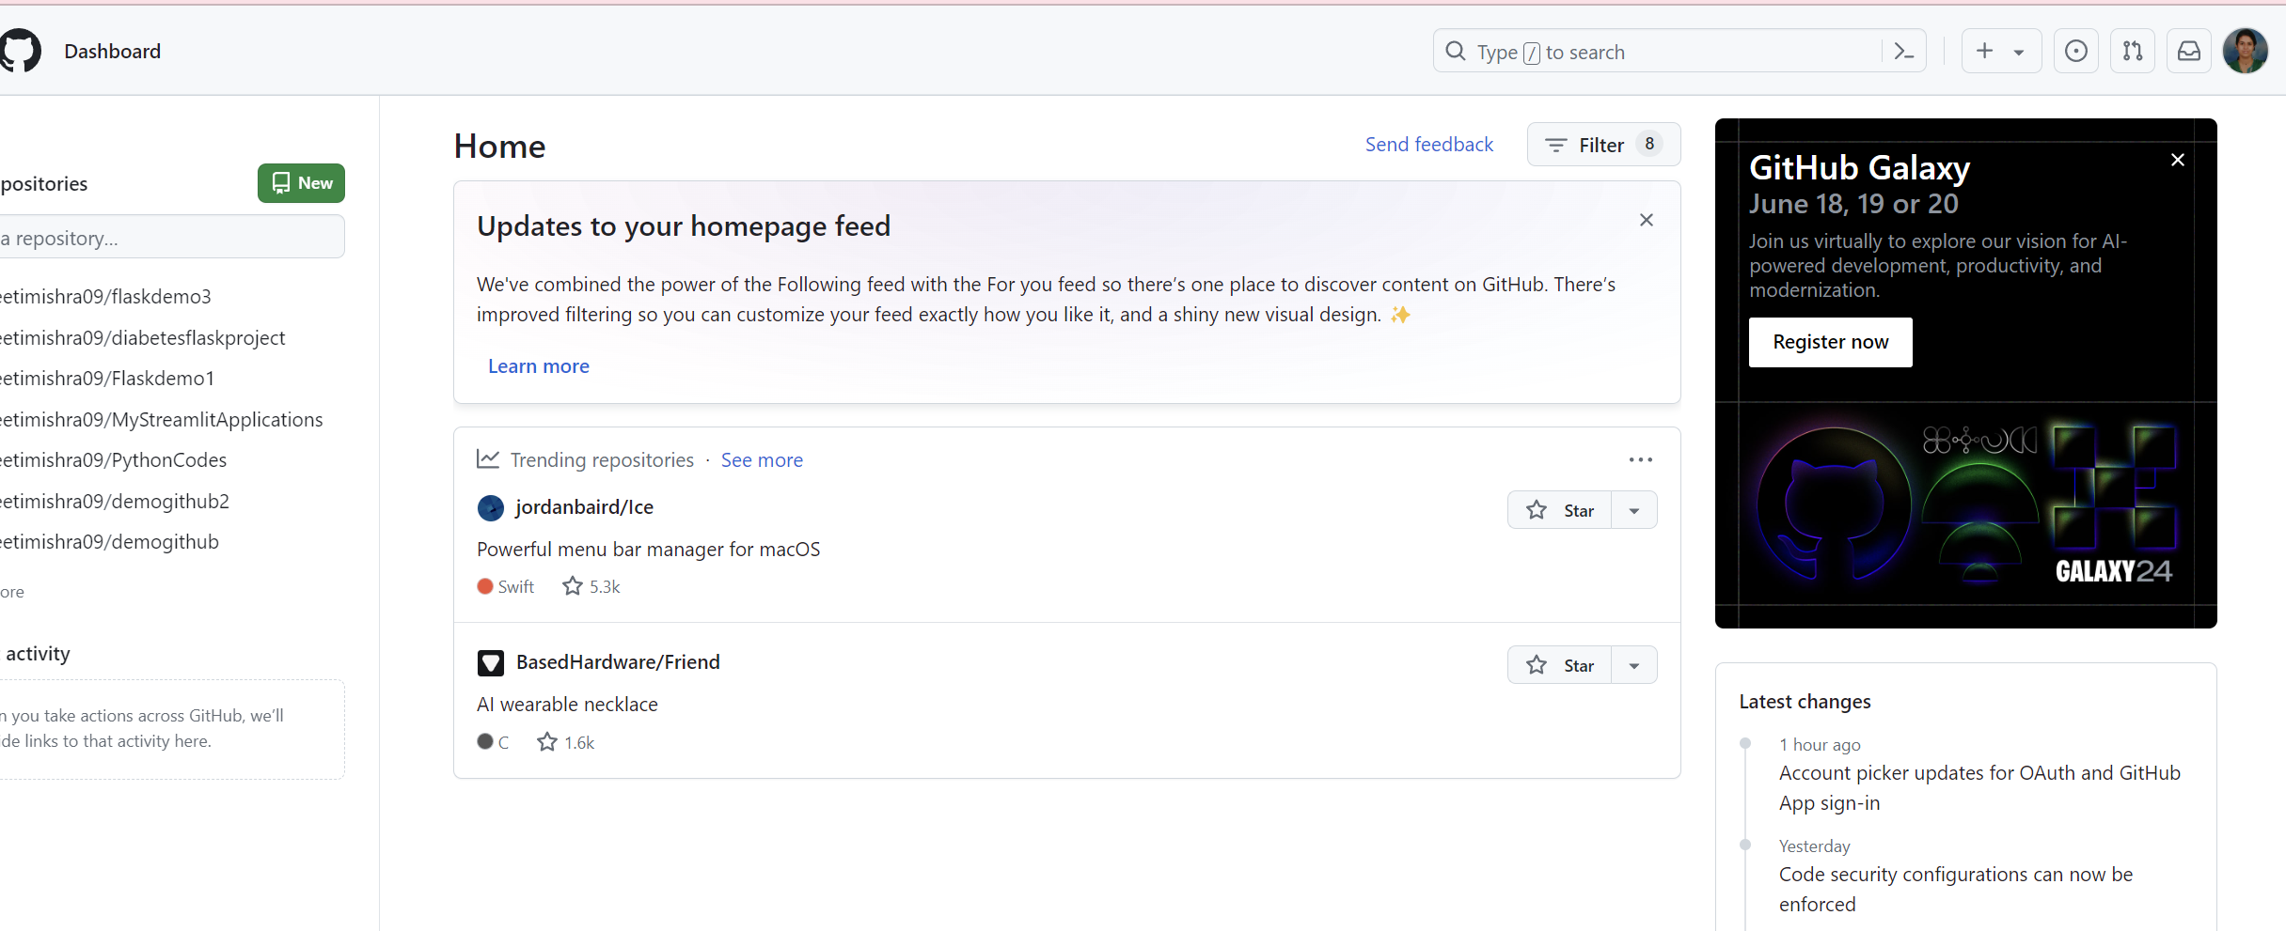
Using GitHub

Slide 49
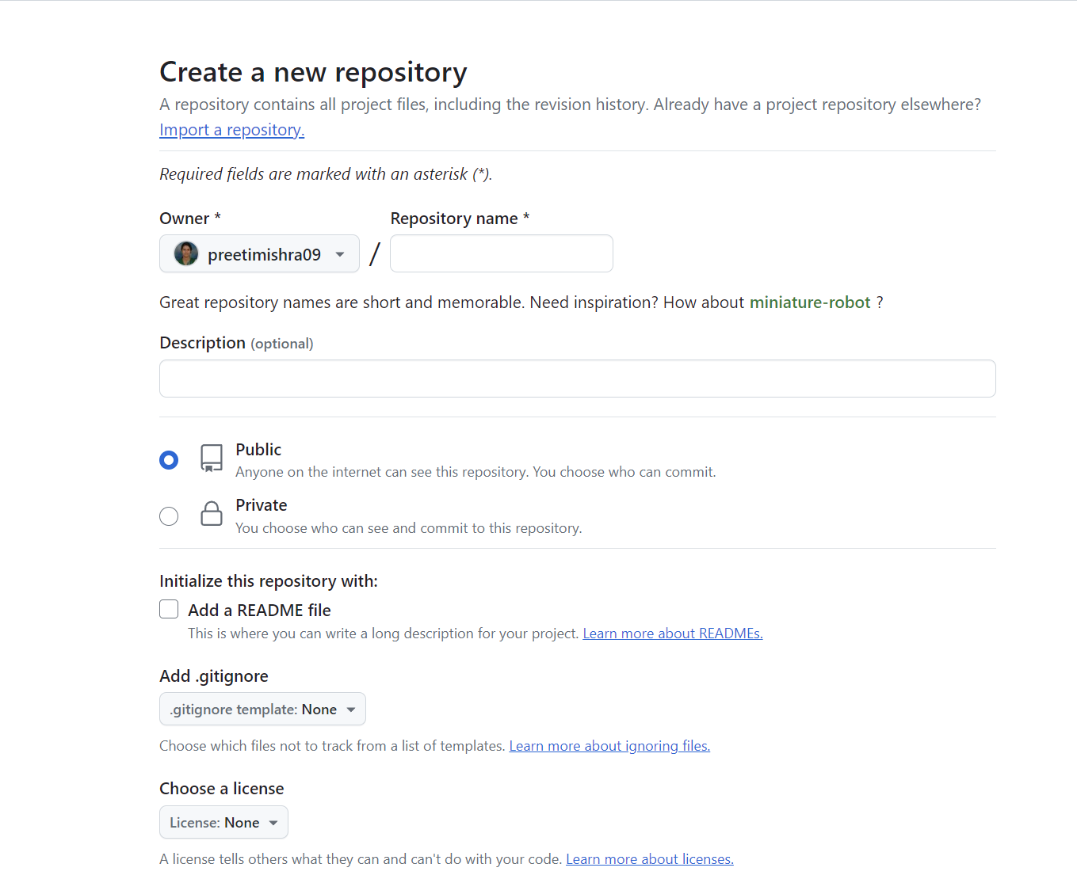
Using GitHub

Slide 50
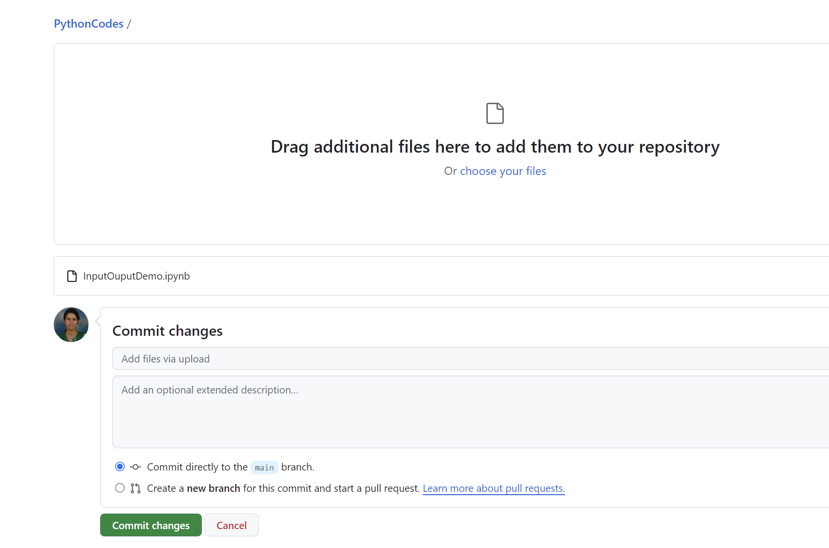
Using GitHub

Slide 51
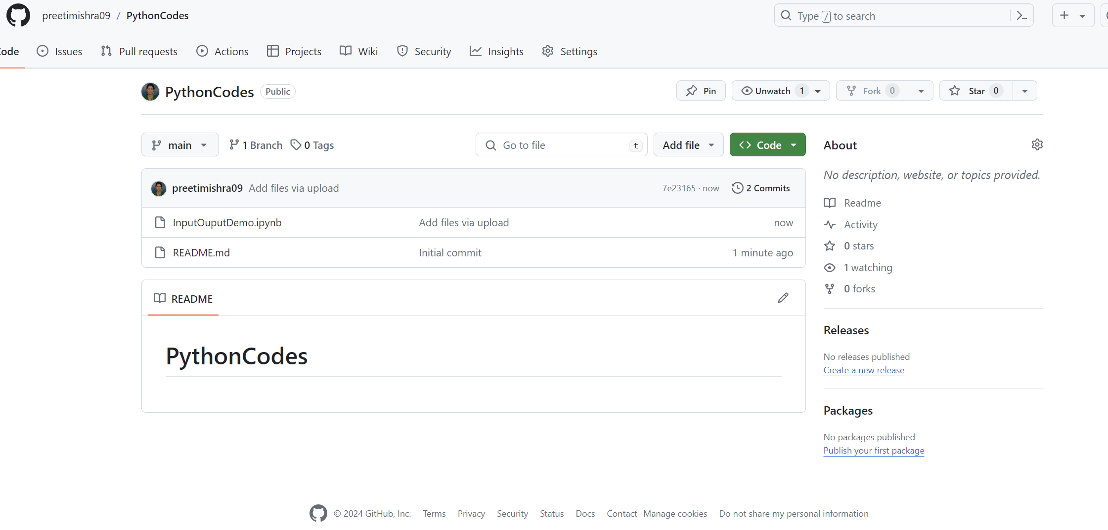
Using GitHub

Slide 52
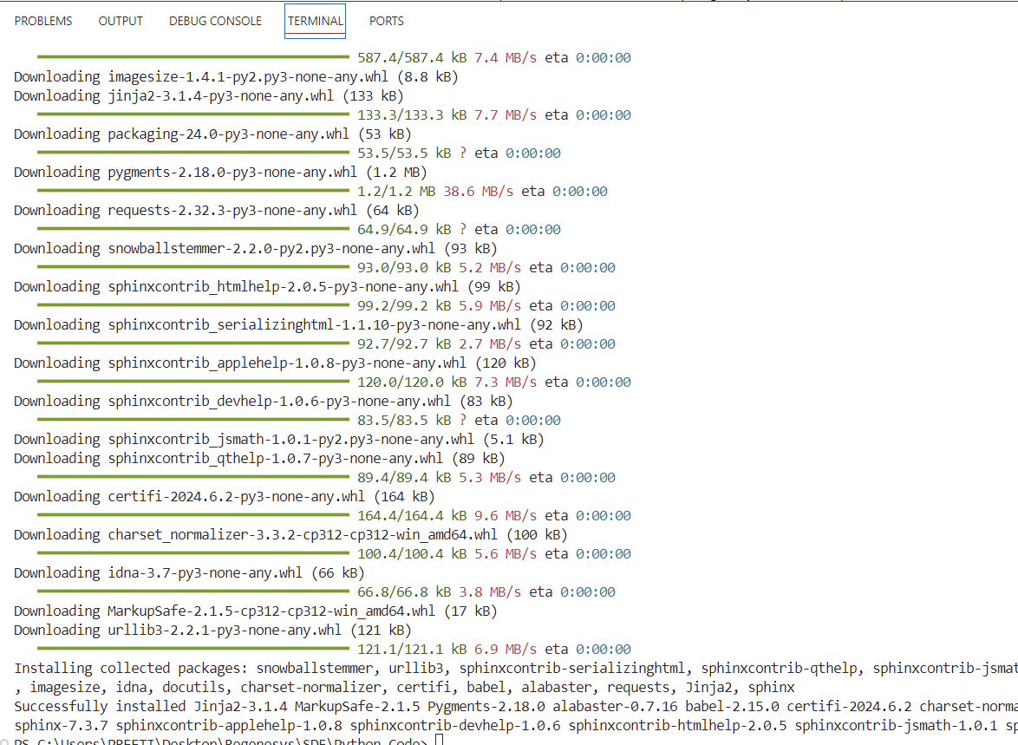
Sphinx
Sphinx is a powerful documentation generator for Python projects.
https://www.youtube.com/watch?v=nZttMg_n_s0
Installation: First, make sure you have Sphinx installed. You can install it using pip:
pip install sphinx

Slide 53
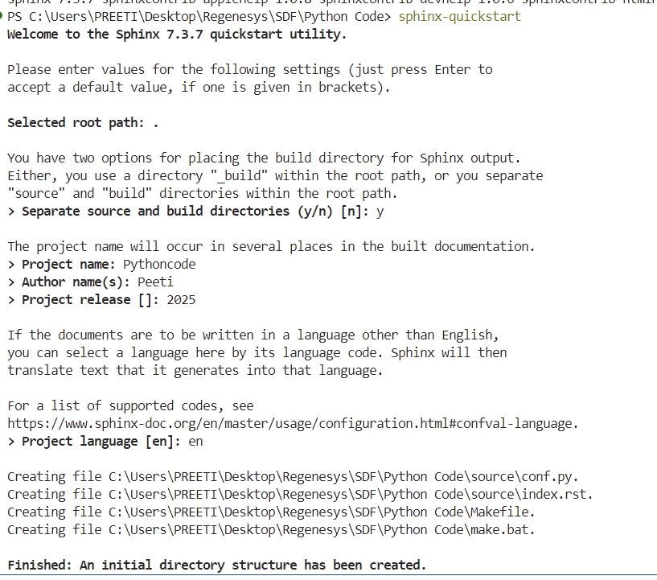
Sphinx
Sphinx is a powerful documentation generator for Python projects.
Create a Source Directory:
Use the sphinx-quickstart command to set up a source directory for your documentation.

Slide 54
Next up..
Tasks
54

Slide 55
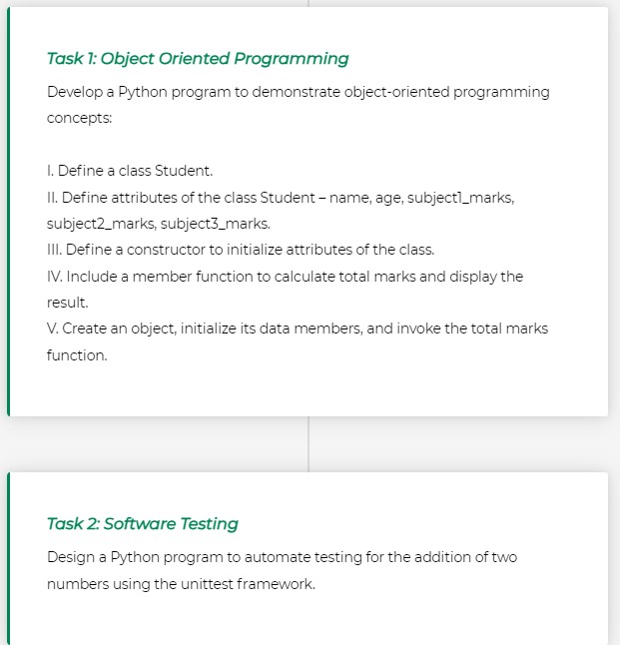
Tasks

Slide 56
Key Points
This section covered essential aspects of Python programming, focusing on OOPs; software testing techniques, including manual and automated testing using the unittest framework; and coding documentation tools, such as pylint, sphinx, and GitHub.
This section provided an in-depth exploration of OOP principles, including classes, objects, inheritance, encapsulation, and polymorphism;
It delved into how classes are defined and instantiated, along with advanced concepts such as inheritance for code reuse, encapsulation for data protection, and polymorphism for interface flexibility;
This section introduced manual testing, a process in which tests are executed manually without automated tools;
This section focuses on automated testing using the unittest framework, a built-in Python module for writing and running tests;
This section explored coding documentation tools such as pylint for code analysis, sphinx for generating documentation from source code, and GitHub for version control and collaboration.
It discussed the role of these tools in improving code quality, maintaining code consistency, and enhancing collaboration among developers.

Slide 57
Next up..
Practice
57

Slide 58
Knowledge Nuggets
Consider the following code snippet:What will be the output of this code, and why?
num=18
if num>10:
print(“Hey")
elif num%3==0:
print("Num is divisible by 3")
else:
print(“Ohhh")

Slide 59
Knowledge Nuggets
What will be printed as output in the following code? And why?
num = 20
if num < 100:
print(“Inter")
if num < 10:
print(“National")
else:
print(“World")

Slide 60
Knowledge Nuggets
The output of following code will be………… Also give reason to support your answer?
Start= -20
Last= -10
Step= 4
for count in range(Start, Last, Step):
print(count, end="\t")

Slide 61
Knowledge Nuggets
The following code will lead to ………..
while(True):
print(“I am in while loop”)

Slide 62
Knowledge Nuggets
The following code will lead to ………..
while(False):
print(“I am in while loop”)

Slide 63
Knowledge Nuggets
Consider the following code:
def sum(a,b):
result=a+b
print(result)
difference(5,6)
difference(6,5)
difference(-5,-6)

Slide 64
Knowledge Nuggets
Consider following code snippet:
x=100
def exchange(x):
x=x/2
print(x)
exchange(x)
print(x)
what will be the output generated by the code and why?

Slide 65
Knowledge Nuggets
The given code snippets demonstrates………. principle of Object Oriented Programming. Give reason to support you answer
class twoD:
def eat(self):
print(“I am 2d Shape")
class threeD(twoD):
def display(self):
# Access the name attribute of the superclass using 'self'
print("My name is", self.name)

Slide 66
Knowledge Nuggets
Given below the code snippet, the output generated when this code is executed will be………….
Give reason to support your answer.
class MyClass:
def __init__(self, x):
self.x = x+10
def display(self):
print(self.x)
x = MyClass(100)
x.display()
y = MyClass(-200)
y.display()

Slide 67
Try out these programs
For each of the below problems, create python program with comments and Provide the output for each test case and explanations for how the code behaves in each scenario.
Even-odd program
Table of 2
Convert degree centigrade to degree Fahrenheit
validates a username and password entered by the user using if–else statements
Calculate grade from marks
calculates the factorial of a given number using a while loop.
To calculate simple interest, accepting principal amount, rate of interest, and duration in years as function parameters
Calculator to perform arithmetic operations based on users choice
Develop a Python program to demonstrate object-oriented programming concepts:
Define a class Student.
Define attributes of the class Student – name, age, subject1_marks, subject2_marks, subject3_marks.
Define a constructor to initialize attributes of the class.
Include a member function to display student details (Student – name, age, subject1_marks, subject2_marks, subject3_mark).
Create an object, initialize its data members, and invoke the total marks function.

Slide 68
Try out these programs
For each of the below problems, create python program with comments and Provide the output for each test case and explanations for how the code behaves in each scenario.
Define a class Student.
Define attributes of the class Student – name, age, subject1_marks, subject2_marks, subject3_marks.
Define a constructor to initialize attributes of the class.
Include a member function to display student details (Student – name, age, subject1_marks, subject2_marks, subject3_mark).
Create an object, initialize its data members, and invoke the total marks function.
Python program to automate testing for addition of two numbers
Python program to implement a user-defined function with a list as a parameter, printing whether each value in the list is even or odd.

Slide 69
Try out these programs
For each of the below problems, create python program with comments and Provide the output for each test case and explanations for how the code behaves in each scenario.
Construct a Python program, with detailed comments, to illustrate the functionality of the following list operations:
1. list()
2. append()
3. insert()
4. sort()
5. reverse()

Slide 70
Try out these programs
For each of the below problems, create python program with comments and Provide the output for each test case and explanations for how the code behaves in each scenario.
Creation and Initialisation of Pandas DataFrame from a CSV file
Viewing Data
Displaying the first 10 rows of the DataFrame.
Retrieving the dimensions (rows, columns) of the DataFrame.
Retrieving the column labels of the DataFrame.
Retrieving the index labels of the DataFrame.
Selection and Indexing
Selecting a single column by name.
Selecting multiple columns by name.
Selecting a row by index.
Filtering
Filtering rows based on a condition.
Sorting
Sorting the DataFrame by the values in a specific column.

Slide 71
Try out these programs
For each of the below problems, create python program with comments and Provide the output for each test case and explanations for how the code behaves in each scenario.
Develop a Python program, accompanied by explanatory comments, that prompts the user for the quantity of coffee cups and the unit price.
Craft a Python program, supported by comments, to convert an amount in South African Rands (ZAR) to the equivalent in US Dollars (USD) using the conversion rate: 1 South African Rand = 0.05 United States Dollar.

Slide 72
We Have Covered
Modular Programming
Object Oriented Programming
Testing
Practice tasks
Key points 2.6
Documentation Tools
Powered by DALL·E 3
72

Slide 73
Thank You!
Email-preeti.m@regenesys.net

